Slide 1
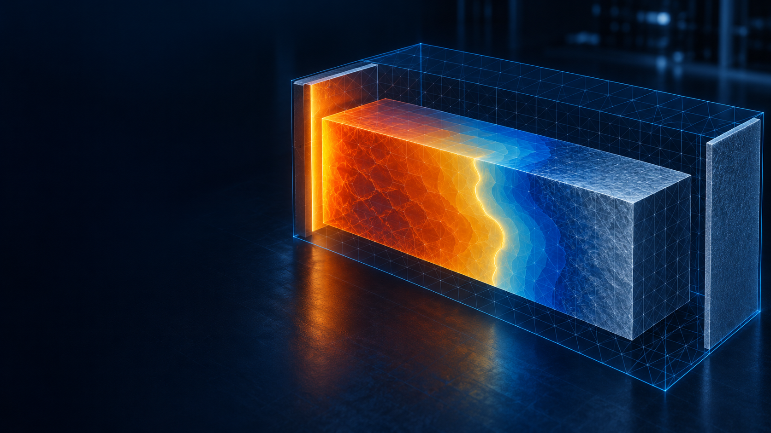
PHASE-CHANGE THERMAL SCREENING
MAT4EU
Phase-Change Evidence
Numerically verified AlSi12 screening — ready for independent sample validation, not a device-performance claim.
SUBMISSION MESSAGE
Submit the numerical evidence and labelled screening predictions. Make experimental material validation the next milestone.
Critical boundary: do not call this experimentally validated until independent sample data exist.
Background: illustrative artwork. Actual calculation plots and demonstration cases: slides 6-11.
MAT4EU · phase-change numerical evidence · KYAMOS
01 / 11

Slide 2

What was actually simulated
ASSUMED SAMPLE · CONTROLLED WALL · IDEALISED SCREENING BOUNDARY
Baseline case
• 40 × 30 × 10 mm dense sample; 31.704 g; initially 500 °C.
• One controlled wall: 620 °C for 40 s, then 500 °C for 20 s.
• Other walls insulated; nominal grid 5 × 3 × 33 cells.
• Domain split over four GPUs on node02 using CUDA-aware MPI.
Model simplifications
• Fixed density and sharp transition at 576 °C.
• No melt motion, container, contact loss, radiation, expansion or cycling damage.
• The example is not a measured storage unit.
Background: illustrative artwork. Actual calculation plots and demonstration cases: slides 6-11.
MAT4EU · phase-change numerical evidence · KYAMOS
02 / 11

Slide 3
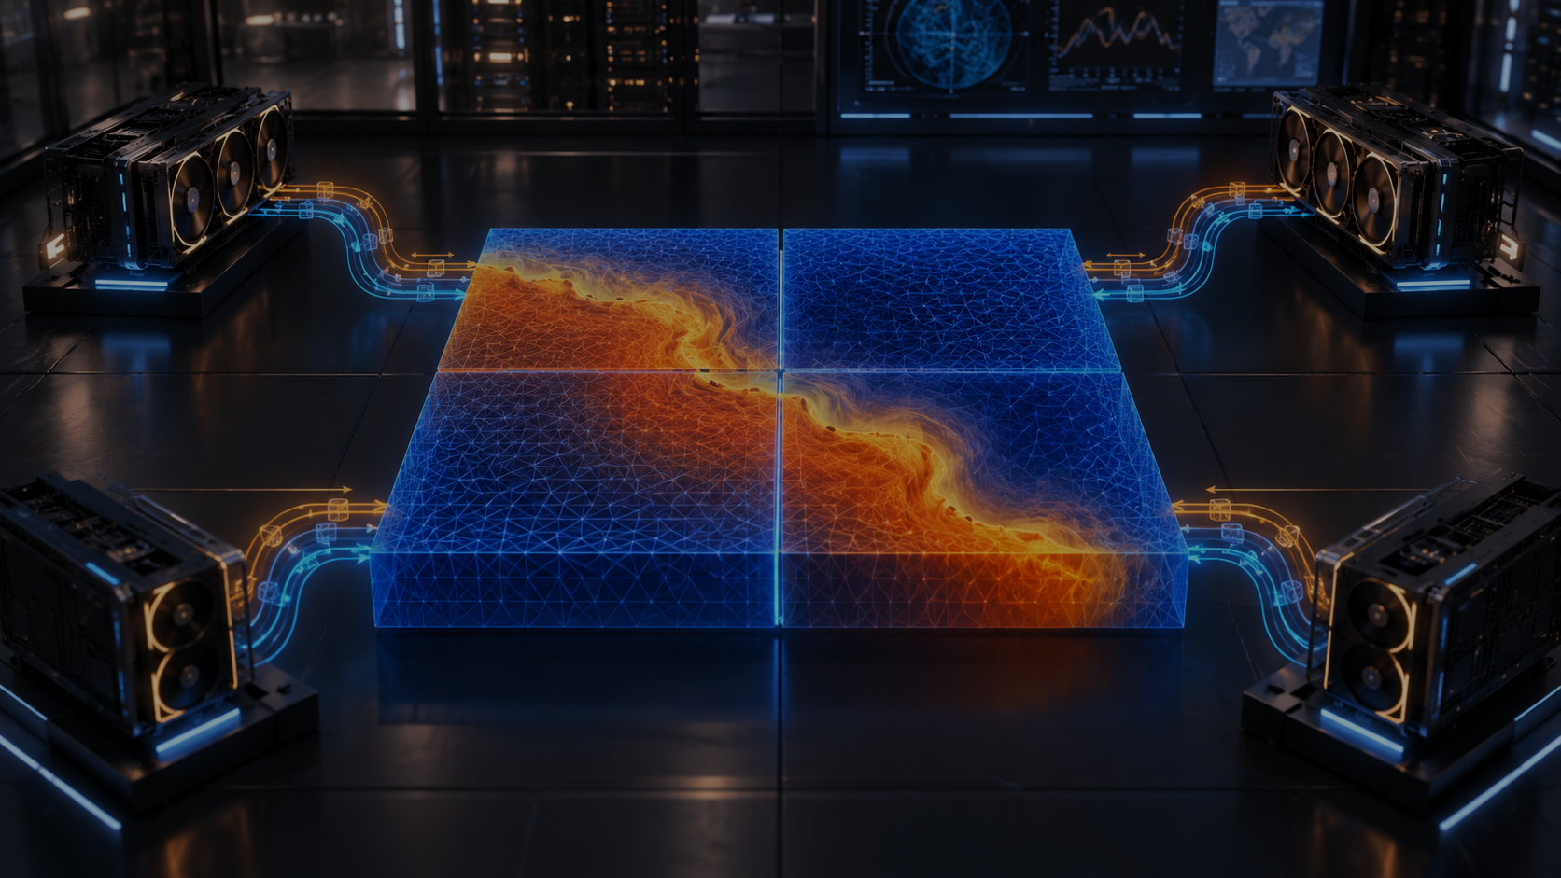
Screening results: heat in, heat out
CONDITIONAL SIMULATION PREDICTIONS — NOT AN EFFICIENCY CLAIM
24.293 kJ
24.293 kJ
25.25–25.50 s
6.00–6.25 s
heat held above initial state at 40 s
heat released in the next 20 s
99% melted bracket
99% frozen after cooling starts
Numerical closure
Residual heat above the initial state at 60 s is 0.00268395 J. Nominal maximum numerical energy residual divided by equilibrium capacity is 1.317×10⁻¹⁴.
Near-complete recovery follows from the ideal insulated setup. It does not prove storage-unit charge/discharge efficiency.
INTERPRETATION CONTROL
Background: illustrative artwork. Actual calculation plots and demonstration cases: slides 6-11.
MAT4EU · phase-change numerical evidence · KYAMOS
03 / 11

Slide 4
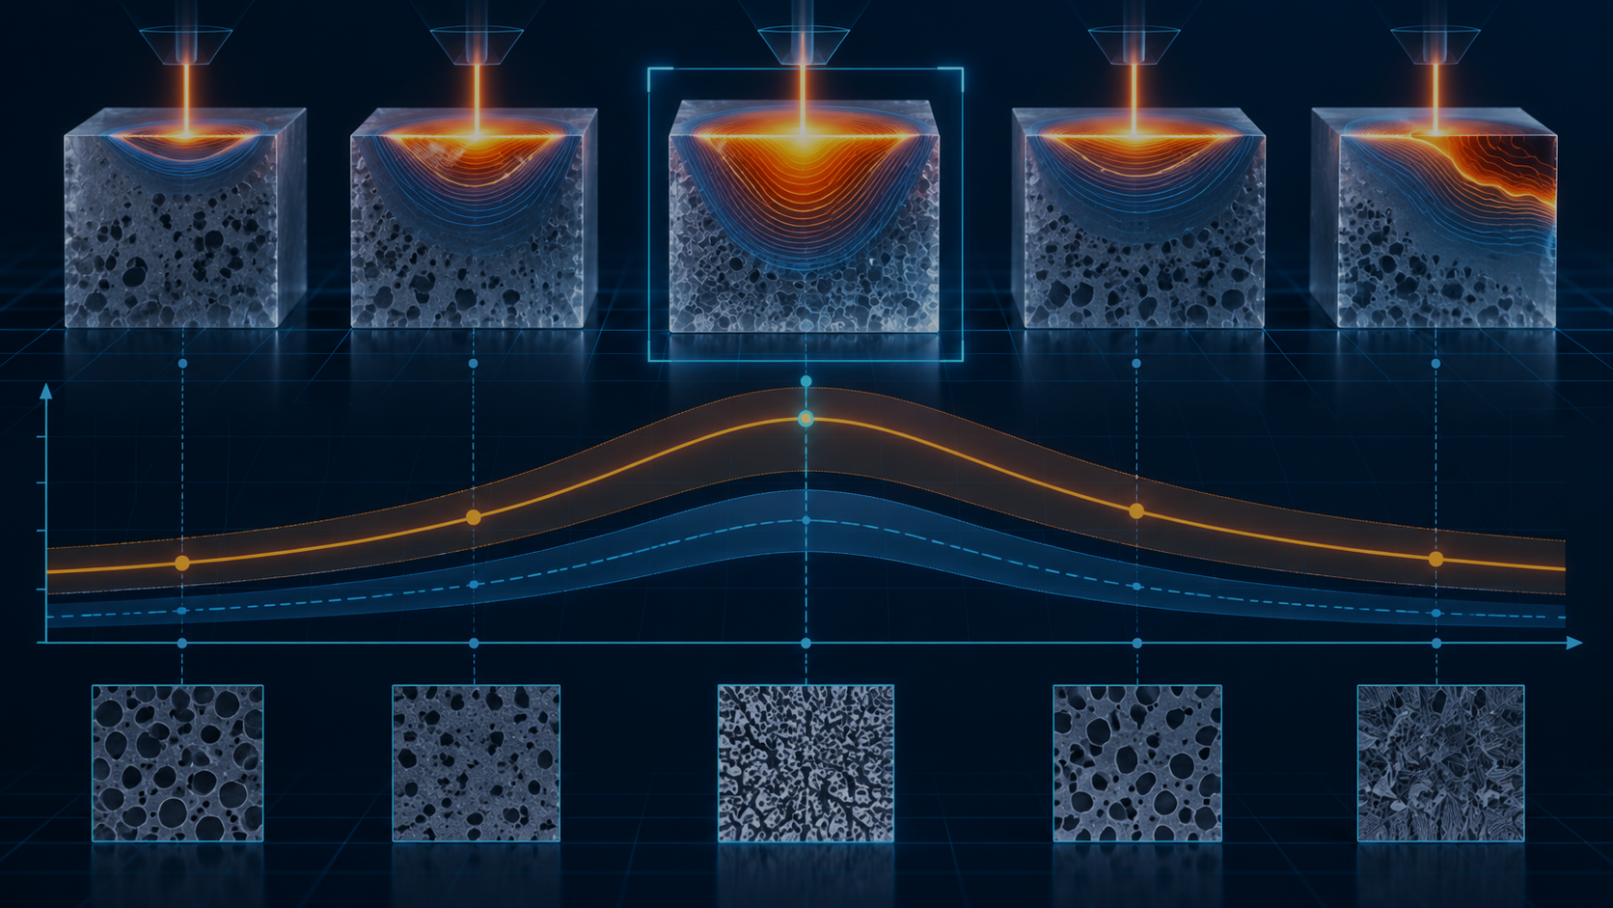
Evidence quality and sensitivity
WORKING GRID PASSED — RAW CAMPAIGN STILL RECORDS ONE REJECTED COARSE GRID
Verification record
Sensitivity message
219 / 220
checks passed; raw status remains FAIL because the 17-plane coarse grid was rejected.
Latent heat mostly changes stored energy; conductivity mostly shifts melt timing. The alternatives are one-property changes — not statistical confidence intervals or supplier tolerances.
• 33-plane working grid passes finer 65-plane and half-time-step comparisons.
• 434 mathematical checks passed across 31 successful cases.
• Finest analytical front error: 0.00773%.
• Resolution trend is not monotonic; no measured convergence order is claimed.
21.445–24.300 kJ
heat stored range across listed alternatives
21.00–31.75 s
99% melt bracket range across listed alternatives
Background: illustrative artwork. Actual calculation plots and demonstration cases: slides 6-11.
MAT4EU · phase-change numerical evidence · KYAMOS
04 / 11

Slide 5
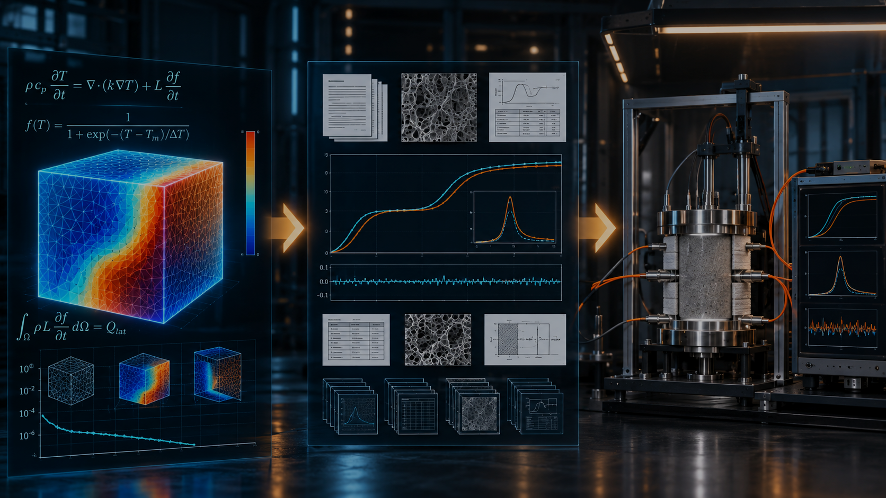
What the project can credibly claim next
CLEAR CLAIM LADDER · INDEPENDENT SAMPLE VALIDATION BEFORE COMMERCIAL PERFORMANCE CLAIMS
Supported now
Recommended jury positioning
• Conservative thermal phase-change calculation numerically verified within stated tests.
• GPU-to-GPU device-buffer communication and matching partitions demonstrated.
• AlSi12 property choices remain literature-screening assumptions.
This is a strong numerical evidence package, but it becomes valuable only when tied to an independent sample test with measured thermal storage, cycling and loss mechanisms.
Not established yet
NEXT MILESTONE
• Material accuracy.
• Actual storage-unit charge/discharge time or efficiency.
• Melt flow, radiation, contact, shrinkage and cycling damage.
Independent material sample validation: measured charge/discharge curves, material batch certificate, sensor calibration, repeat cycles, and explicit comparison to the simulated boundary.
Do not let impressive visuals hide the missing experiment.
Background: illustrative artwork. Actual calculation plots and demonstration cases: slides 6-11.
MAT4EU · phase-change numerical evidence · KYAMOS
05 / 11

Slide 6
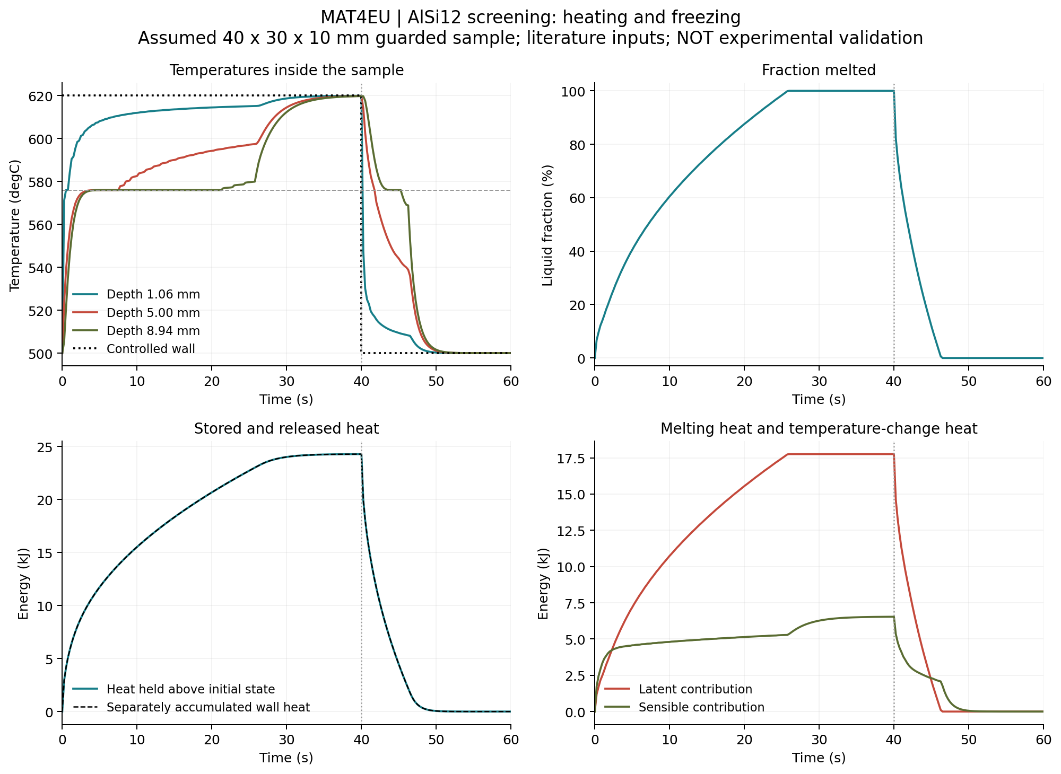
Case 1 | Heating and freezing
A small assumed sample stores heat as it melts, then releases heat as it freezes.
SETUP
40 x 30 x 10 mm sample. One wall: 620 C for 40 s, then 500 C for 20 s. Other walls insulated.
READ THE CURVES
24.293 kJ of heat stored after 40 s. Here kJ means kilojoules, a unit of heat.
TIMING
99% melted: 25.25-25.50 s.
99% frozen: 6.00-6.25 s after cooling starts.
LIMIT
Ideal sample prediction. Near-complete heat recovery is not a storage-unit efficiency result.
MAT4EU | Saved numerical evidence, 15 Sep 2026 | Figure: 01_heating_freezing_cycle.png
06 / 11
Notes:
Case 1 | Heating and freezing
A small assumed sample stores heat as it melts, then releases heat as it freezes.
SETUP: 40 x 30 x 10 mm sample. One wall: 620 C for 40 s, then 500 C for 20 s. Other walls insulated.
READ THE CURVES: 24.293 kJ of heat stored after 40 s. Here kJ means kilojoules, a unit of heat.
TIMING: 99% melted: 25.25-25.50 s.
99% frozen: 6.00-6.25 s after cooling starts.
LIMIT: Ideal sample prediction. Near-complete heat recovery is not a storage-unit efficiency result.
Unchanged figure source: proposal_20260915/submission_pack/01_heating_freezing_cycle.png
Evidence: REPORT.md, screening_claim.json, baseline_qualification.json and benchmark_evidence/claim.json.
Literature-based screening only. No new calculation or experimental validation in this presentation update.

Slide 7
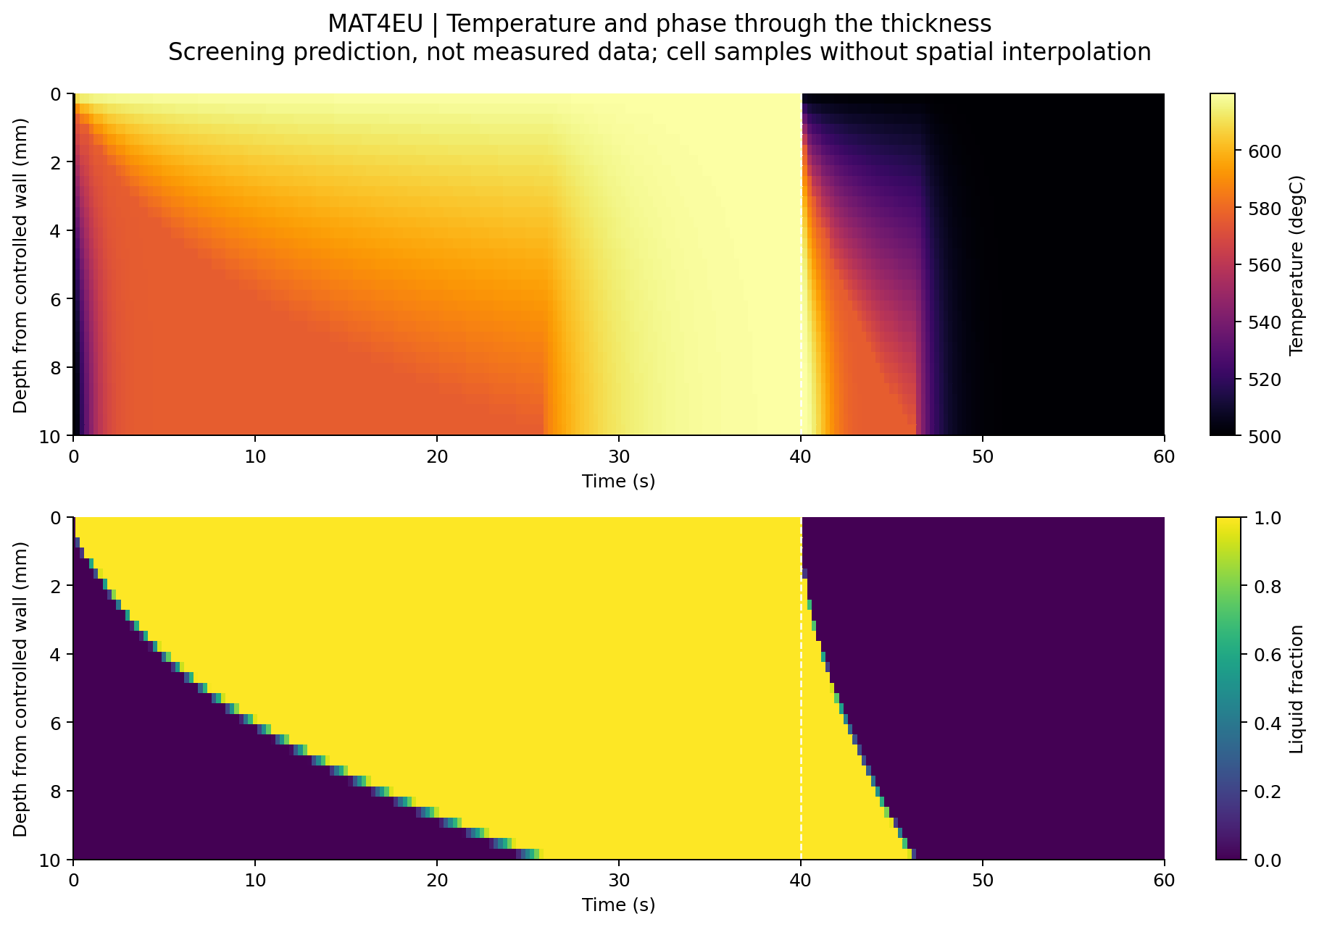
Case 1 | Where the sample melts
The saved fields show temperature and melting progress through the sample depth.
HOW TO READ
Temperature shows how hot each location is. Liquid fraction means the melted share: 0 is solid, 1 is liquid.
WHAT IS SHOWN
The same heating and freezing case as the previous slide. The wall temperature changes after 40 s.
TIME BRACKETS
The melting and freezing brackets come from saved readings every 0.25 s. They are not experimental error bars.
LIMIT
Heat conduction only. Liquid motion and container effects are excluded.
MAT4EU | Saved numerical evidence, 15 Sep 2026 | Figure: 02_phase_progress.png
07 / 11
Notes:
Case 1 | Where the sample melts
The saved fields show temperature and melting progress through the sample depth.
HOW TO READ: Temperature shows how hot each location is. Liquid fraction means the melted share: 0 is solid, 1 is liquid.
WHAT IS SHOWN: The same heating and freezing case as the previous slide. The wall temperature changes after 40 s.
TIME BRACKETS: The melting and freezing brackets come from saved readings every 0.25 s. They are not experimental error bars.
LIMIT: Heat conduction only. Liquid motion and container effects are excluded.
Unchanged figure source: proposal_20260915/submission_pack/02_phase_progress.png
Evidence: REPORT.md, screening_claim.json, baseline_qualification.json and benchmark_evidence/claim.json.
Literature-based screening only. No new calculation or experimental validation in this presentation update.

Slide 8
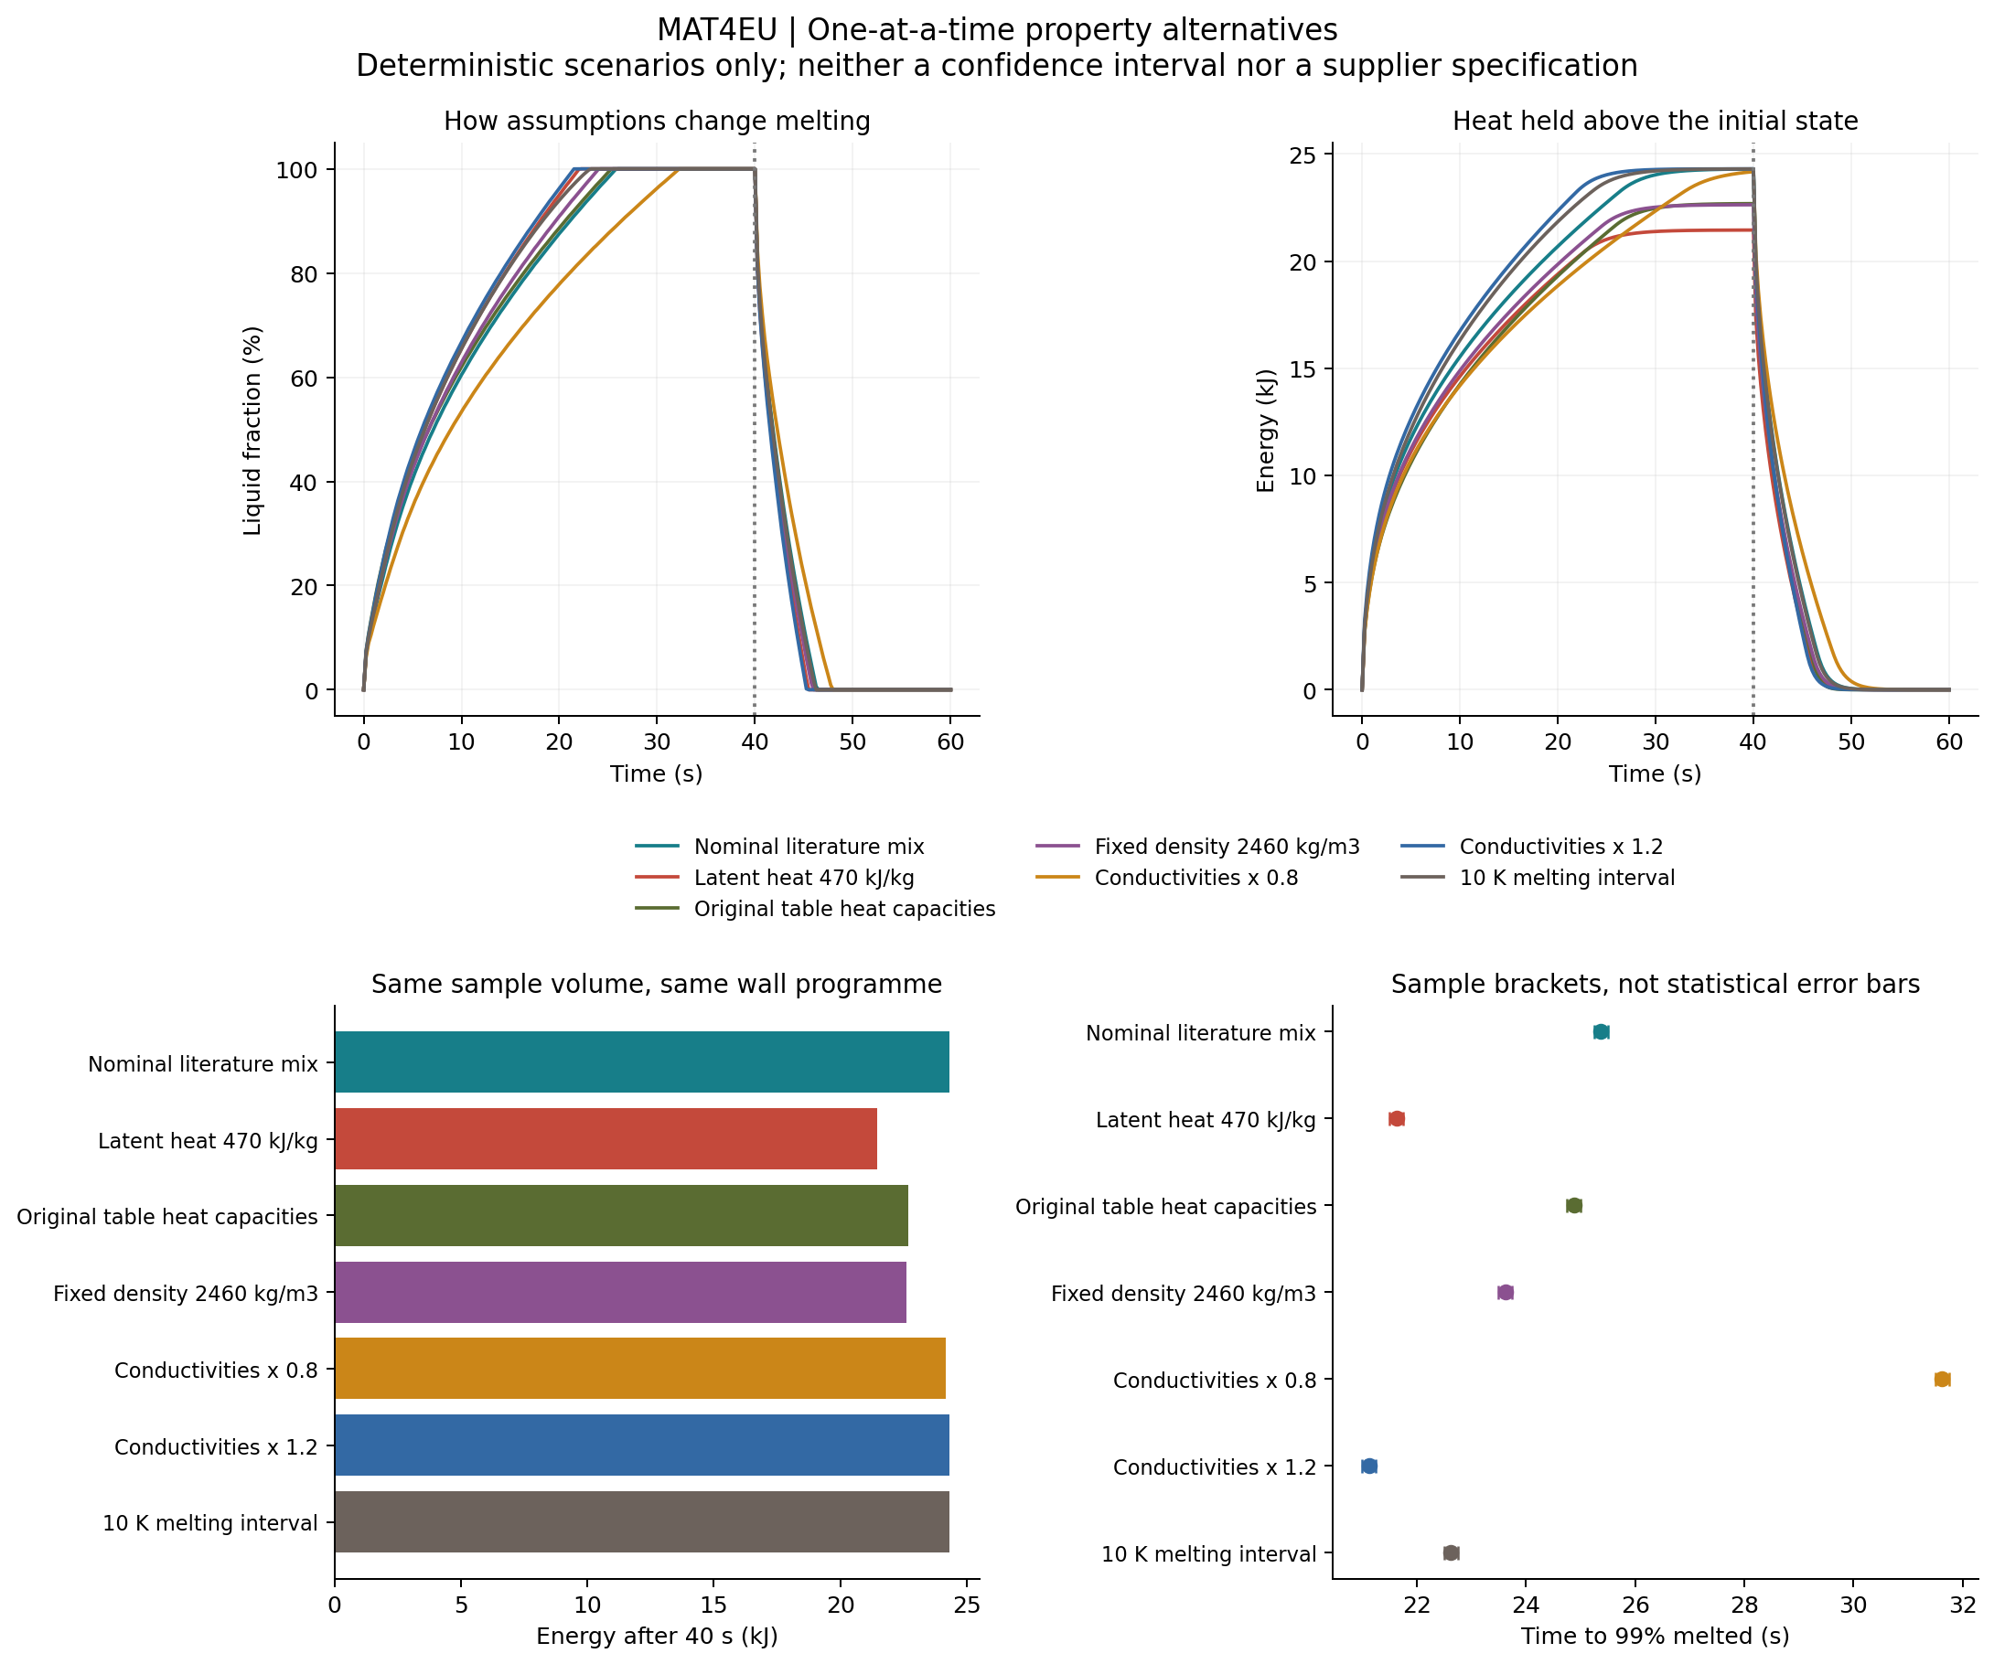
Case 2 | Material-property alternatives
Changing one assumed property at a time shows why measured material inputs matter.
STORED HEAT
21.445-24.300 kJ across the seven listed scenarios.
MELTING TIME
99% melt brackets span 21.00-31.75 s across those scenarios.
HOW TO READ
Latent heat [heat needed to melt] mainly changes stored heat. Conductivity [ease of heat travel] mainly changes timing.
LIMIT
These are selected alternatives, not measured supplier limits or a statistical uncertainty range.
MAT4EU | Saved numerical evidence, 15 Sep 2026 | Figure: 03_property_sensitivity.png
08 / 11
Notes:
Case 2 | Material-property alternatives
Changing one assumed property at a time shows why measured material inputs matter.
STORED HEAT: 21.445-24.300 kJ across the seven listed scenarios.
MELTING TIME: 99% melt brackets span 21.00-31.75 s across those scenarios.
HOW TO READ: Latent heat [heat needed to melt] mainly changes stored heat. Conductivity [ease of heat travel] mainly changes timing.
LIMIT: These are selected alternatives, not measured supplier limits or a statistical uncertainty range.
Unchanged figure source: proposal_20260915/submission_pack/03_property_sensitivity.png
Evidence: REPORT.md, screening_claim.json, baseline_qualification.json and benchmark_evidence/claim.json.
Literature-based screening only. No new calculation or experimental validation in this presentation update.

Slide 9
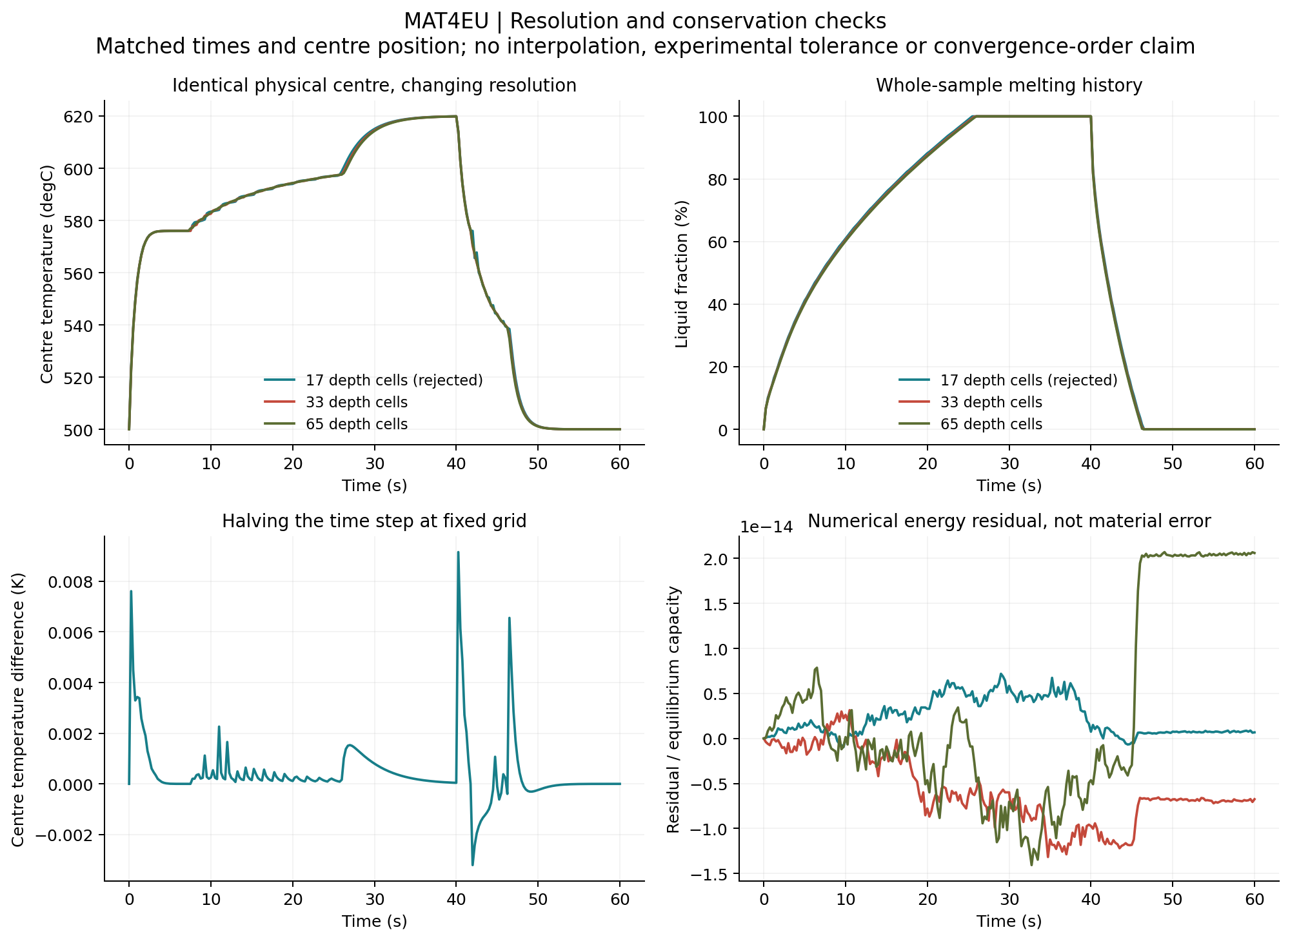
Check 1 | Grid and time-step comparisons
The working grid passed its declared checks. The rejected coarse-grid failure remains recorded.
WHAT A GRID MEANS
The sample is divided into small cells for calculation. More cells allow a finer comparison.
WORKING GRID
33 versus 65 depth cells: largest centre-temperature difference 1.421 C. Limit: 3 C.
TIME STEP
Halving the time step changes centre temperature by at most 0.0092 C.
REJECTED CASE
17 depth cells: 5.749 C difference. Raw record: 219/220 pass, overall FAIL. Only the working grid is accepted.
MAT4EU | Saved numerical evidence, 15 Sep 2026 | Figure: 04_resolution_checks.png
09 / 11
Notes:
Check 1 | Grid and time-step comparisons
The working grid passed its declared checks. The rejected coarse-grid failure remains recorded.
WHAT A GRID MEANS: The sample is divided into small cells for calculation. More cells allow a finer comparison.
WORKING GRID: 33 versus 65 depth cells: largest centre-temperature difference 1.421 C. Limit: 3 C.
TIME STEP: Halving the time step changes centre temperature by at most 0.0092 C.
REJECTED CASE: 17 depth cells: 5.749 C difference. Raw record: 219/220 pass, overall FAIL. Only the working grid is accepted.
Unchanged figure source: proposal_20260915/submission_pack/04_resolution_checks.png
Evidence: REPORT.md, screening_claim.json, baseline_qualification.json and benchmark_evidence/claim.json.
Literature-based screening only. No new calculation or experimental validation in this presentation update.

Slide 10
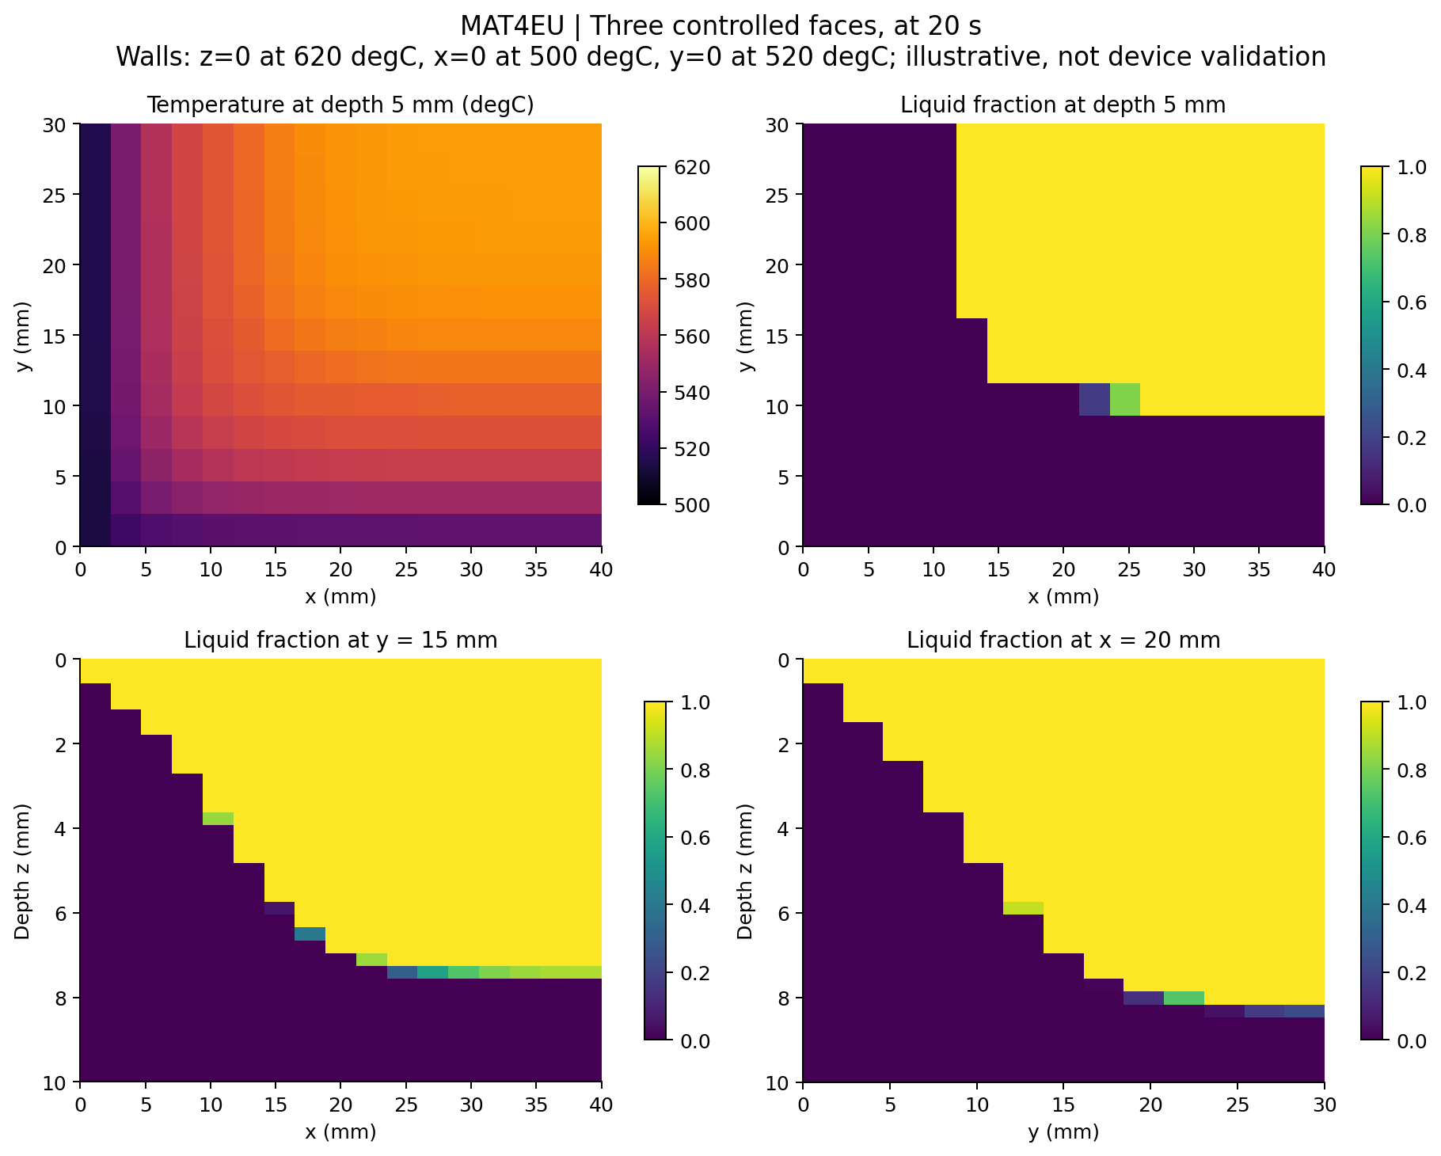
Case 3 | Three-dimensional demonstration
Different temperatures on three faces create a field that varies in all three directions.
SETUP
Same sample size; initially 500 C. Three faces held at 620 C, 500 C and 520 C. Other faces insulated.
SAVED RESULT
Field after 20 s, using 17 x 13 x 33 cells. Colour shows the calculated temperature or melted share.
PURPOSE
Demonstrates a three-dimensional calculation beyond the one-wall baseline.
LIMIT
Auxiliary demonstration. This case has no independent grid-accuracy qualification or device-performance claim.
MAT4EU | Saved numerical evidence, 15 Sep 2026 | Figure: 05_three_dimensional_example.png
10 / 11
Notes:
Case 3 | Three-dimensional demonstration
Different temperatures on three faces create a field that varies in all three directions.
SETUP: Same sample size; initially 500 C. Three faces held at 620 C, 500 C and 520 C. Other faces insulated.
SAVED RESULT: Field after 20 s, using 17 x 13 x 33 cells. Colour shows the calculated temperature or melted share.
PURPOSE: Demonstrates a three-dimensional calculation beyond the one-wall baseline.
LIMIT: Auxiliary demonstration. This case has no independent grid-accuracy qualification or device-performance claim.
Unchanged figure source: proposal_20260915/submission_pack/05_three_dimensional_example.png
Evidence: REPORT.md, screening_claim.json, baseline_qualification.json and benchmark_evidence/claim.json.
Literature-based screening only. No new calculation or experimental validation in this presentation update.

Slide 11
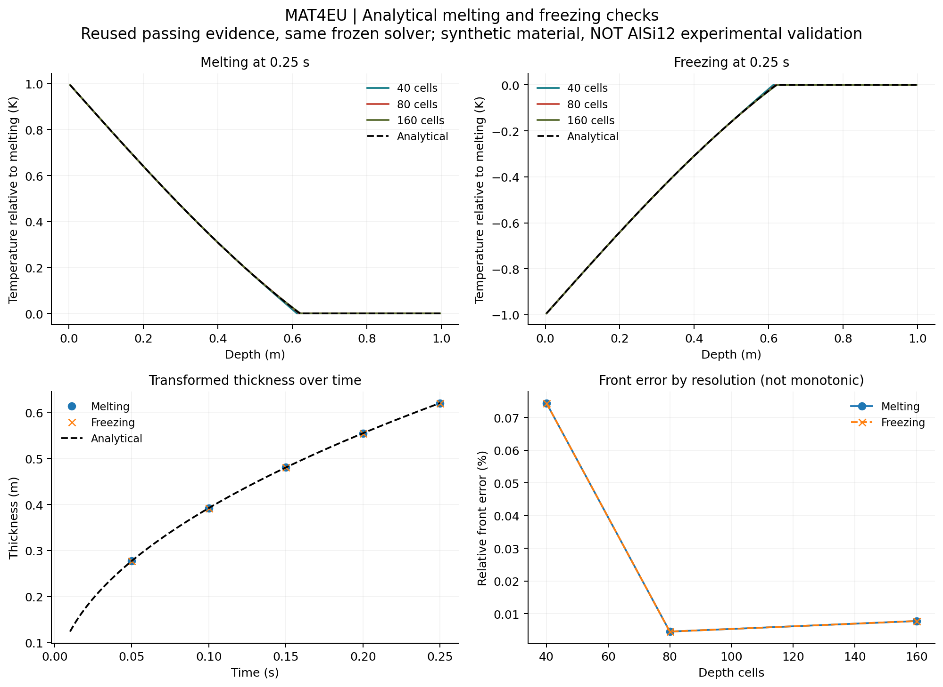
Check 2 | Exact mathematical comparisons
Separate melting and freezing examples are checked against known mathematical solutions.
EXISTING EVIDENCE
434 checks passed across 31 successful cases, using the same calculation source and executable.
FRONT ERROR
Finest melting/freezing front-position error: 0.00773%. This checks the position where solid meets liquid.
INTERPRETATION
The front-error trend is not steadily decreasing. No measured convergence order is claimed.
NEXT MILESTONE
Compare with independently measured sample temperatures and stored heat. Material validation remains unestablished.
MAT4EU | Saved numerical evidence, 15 Sep 2026 | Figure: 06_analytical_verification.png
11 / 11
Notes:
Check 2 | Exact mathematical comparisons
Separate melting and freezing examples are checked against known mathematical solutions.
EXISTING EVIDENCE: 434 checks passed across 31 successful cases, using the same calculation source and executable.
FRONT ERROR: Finest melting/freezing front-position error: 0.00773%. This checks the position where solid meets liquid.
INTERPRETATION: The front-error trend is not steadily decreasing. No measured convergence order is claimed.
NEXT MILESTONE: Compare with independently measured sample temperatures and stored heat. Material validation remains unestablished.
Unchanged figure source: proposal_20260915/submission_pack/06_analytical_verification.png
Evidence: REPORT.md, screening_claim.json, baseline_qualification.json and benchmark_evidence/claim.json.
Literature-based screening only. No new calculation or experimental validation in this presentation update.

