Slide 1
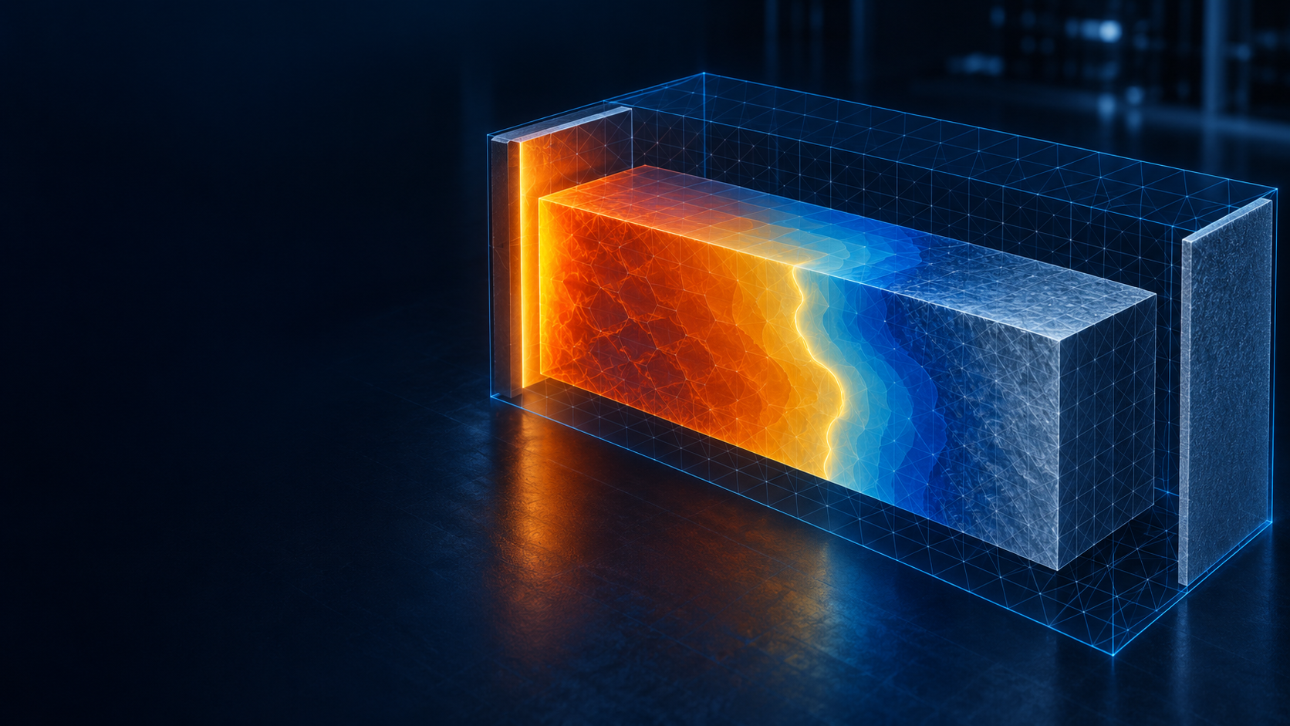
PHASE-CHANGE THERMAL SCREENING
MAT4EU
Phase-Change Evidence
Numerically verified AlSi12 screening — ready for independent sample validation, not a device-performance claim.
SUBMISSION MESSAGE
Submit the numerical evidence and labelled screening predictions. Make experimental material validation the next milestone.
Critical boundary: do not call this experimentally validated until independent sample data exist.
MAT4EU · phase-change numerical evidence · KYAMOS
01 / 05

Slide 2

What was actually simulated
ASSUMED SAMPLE · CONTROLLED WALL · IDEALISED SCREENING BOUNDARY
Baseline case
• 40 × 30 × 10 mm dense sample; 31.704 g; initially 500 °C.
• One controlled wall: 620 °C for 40 s, then 500 °C for 20 s.
• Other walls insulated; nominal grid 5 × 3 × 33 cells.
• Domain split over four GPUs on node02 using CUDA-aware MPI.
Model simplifications
• Fixed density and sharp transition at 576 °C.
• No melt motion, container, contact loss, radiation, expansion or cycling damage.
• The example is not a measured storage unit.
MAT4EU · phase-change numerical evidence · KYAMOS
02 / 05

Slide 3
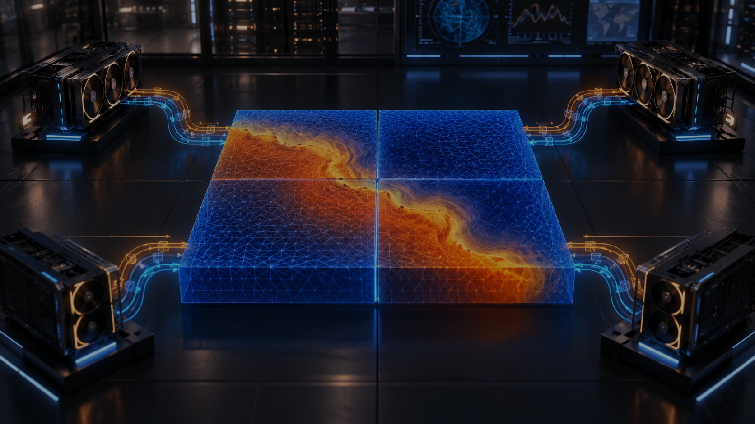
Screening results: heat in, heat out
CONDITIONAL SIMULATION PREDICTIONS — NOT AN EFFICIENCY CLAIM
24.293 kJ
24.293 kJ
25.25–25.50 s
6.00–6.25 s
heat held above initial state at 40 s
heat released in the next 20 s
99% melted bracket
99% frozen after cooling starts
Numerical closure
Residual heat above the initial state at 60 s is 0.00268395 J. Nominal maximum numerical energy residual divided by equilibrium capacity is 1.317×10⁻¹⁴.
Near-complete recovery follows from the ideal insulated setup. It does not prove storage-unit charge/discharge efficiency.
INTERPRETATION CONTROL
MAT4EU · phase-change numerical evidence · KYAMOS
03 / 05

Slide 4
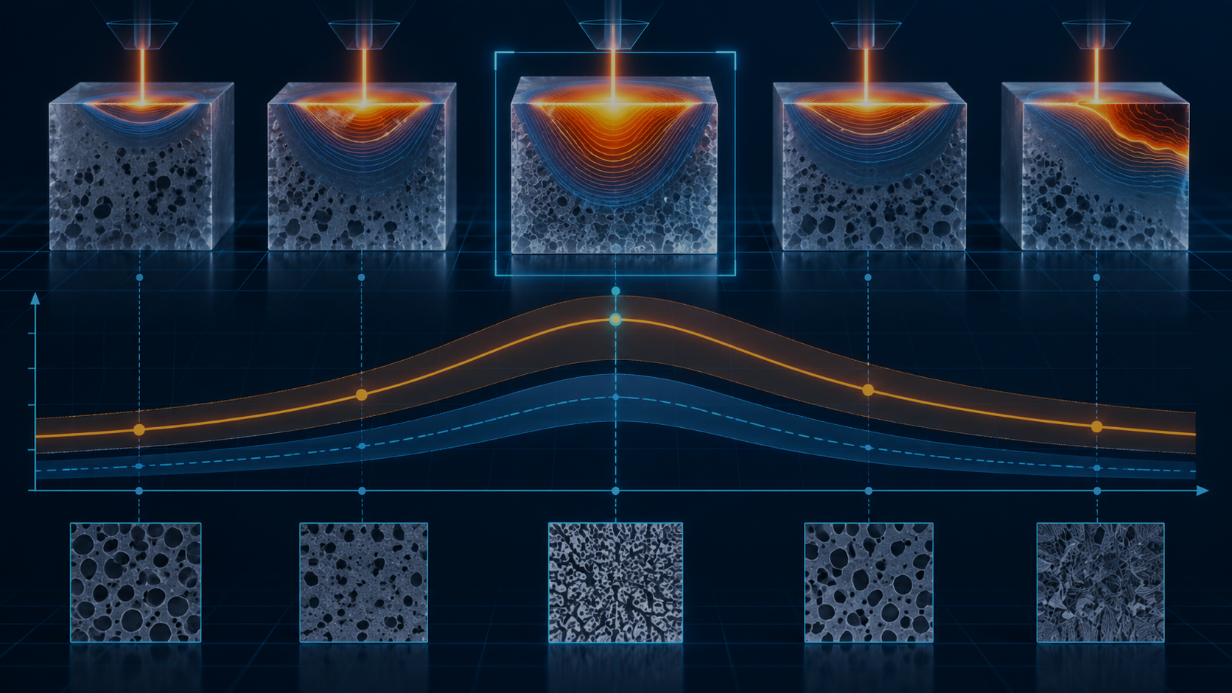
Evidence quality and sensitivity
WORKING GRID PASSED — RAW CAMPAIGN STILL RECORDS ONE REJECTED COARSE GRID
Verification record
Sensitivity message
219 / 220
checks passed; raw status remains FAIL because the 17-plane coarse grid was rejected.
Latent heat mostly changes stored energy; conductivity mostly shifts melt timing. The alternatives are one-property changes — not statistical confidence intervals or supplier tolerances.
• 33-plane working grid passes finer 65-plane and half-time-step comparisons.
• 434 mathematical checks passed across 31 successful cases.
• Finest analytical front error: 0.00773%.
• Resolution trend is not monotonic; no measured convergence order is claimed.
21.445–24.300 kJ
heat stored range across listed alternatives
21.00–31.75 s
99% melt bracket range across listed alternatives
MAT4EU · phase-change numerical evidence · KYAMOS
04 / 05

Slide 5
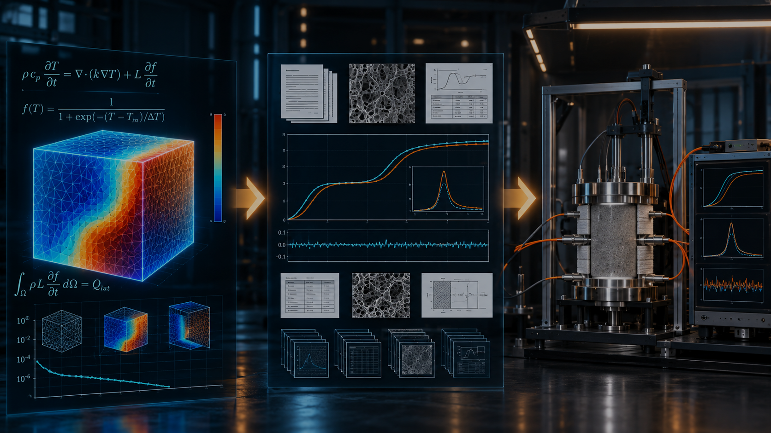
What the project can credibly claim next
CLEAR CLAIM LADDER · INDEPENDENT SAMPLE VALIDATION BEFORE COMMERCIAL PERFORMANCE CLAIMS
Supported now
Recommended jury positioning
• Conservative thermal phase-change calculation numerically verified within stated tests.
• GPU-to-GPU device-buffer communication and matching partitions demonstrated.
• AlSi12 property choices remain literature-screening assumptions.
This is a strong numerical evidence package, but it becomes valuable only when tied to an independent sample test with measured thermal storage, cycling and loss mechanisms.
Not established yet
NEXT MILESTONE
• Material accuracy.
• Actual storage-unit charge/discharge time or efficiency.
• Melt flow, radiation, contact, shrinkage and cycling damage.
Independent material sample validation: measured charge/discharge curves, material batch certificate, sensor calibration, repeat cycles, and explicit comparison to the simulated boundary.
Do not let impressive visuals hide the missing experiment.
MAT4EU · phase-change numerical evidence · KYAMOS
05 / 05

